Slide 1
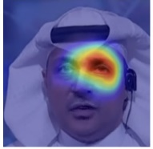
Task1 True
Task1 Fake
Task2 True
Task2 Fake
Task3 True
Task3 Fake
Task4 True
Task4 Fake
LWF
FT
Ours

Slide 2
Task1 True
Task1 Fake
Task2 True
Task2 Fake
Task3 True
Task3 Fake
Task4 True
Task4 Fake
LWF
FT
Ours

Slide 3
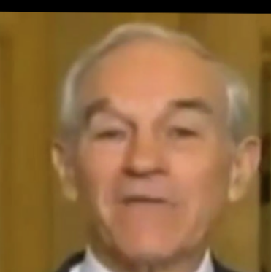
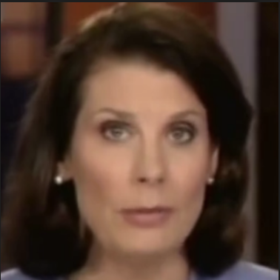

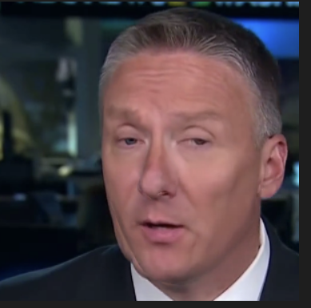
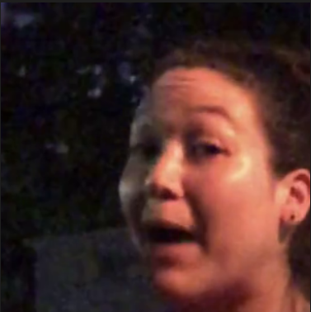
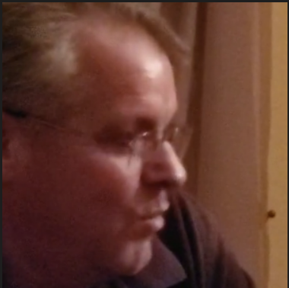
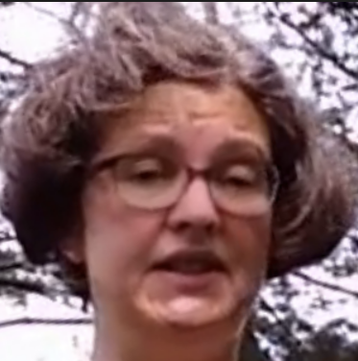
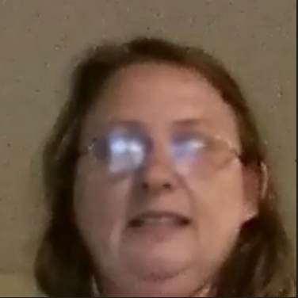

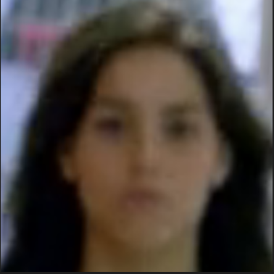
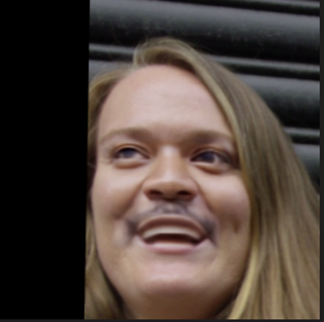
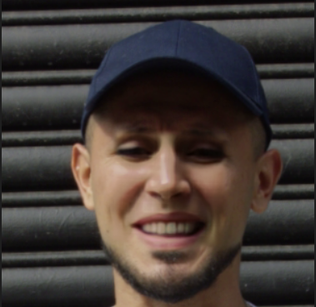
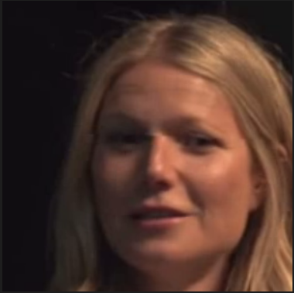


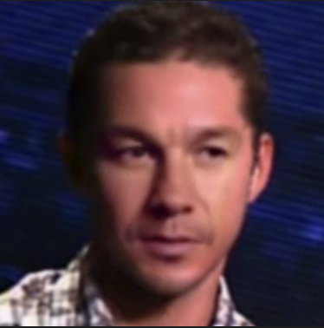
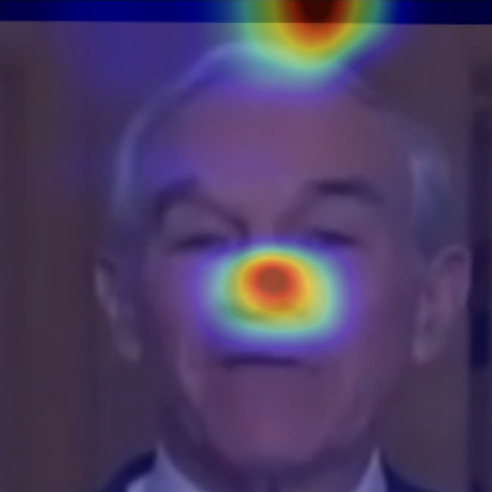
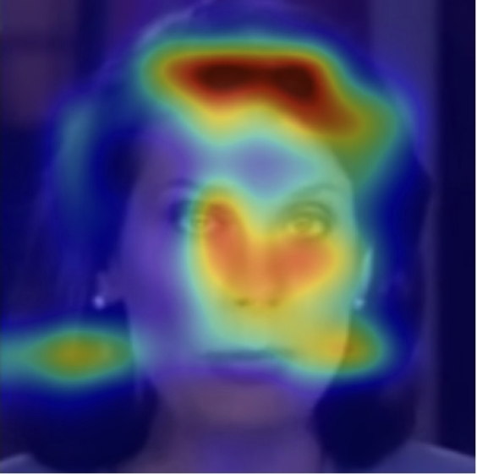
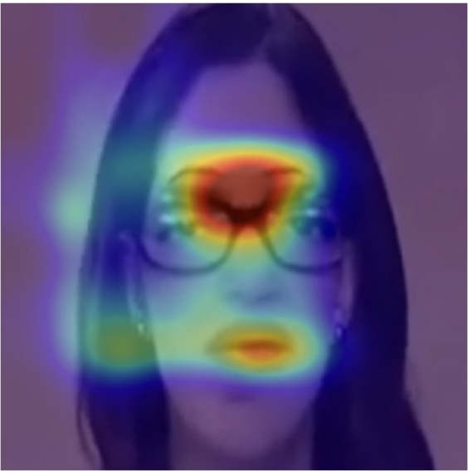
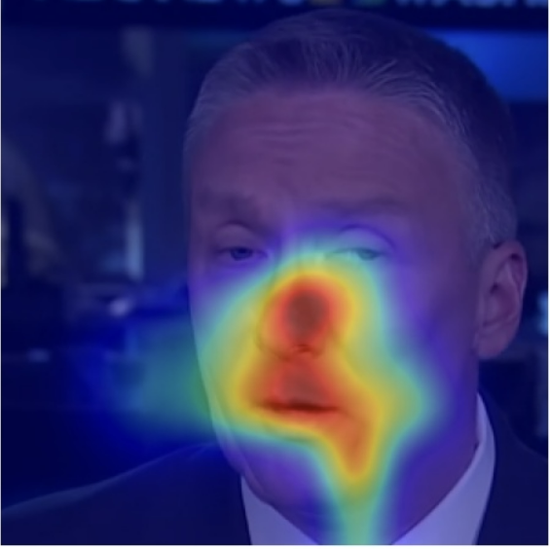
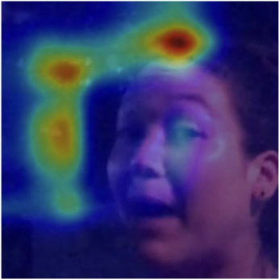
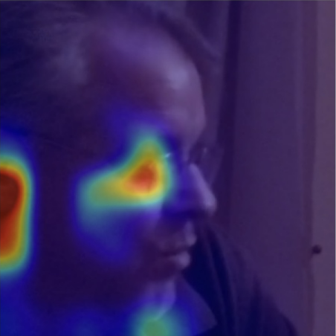
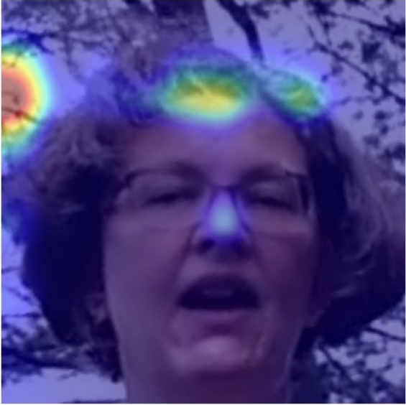
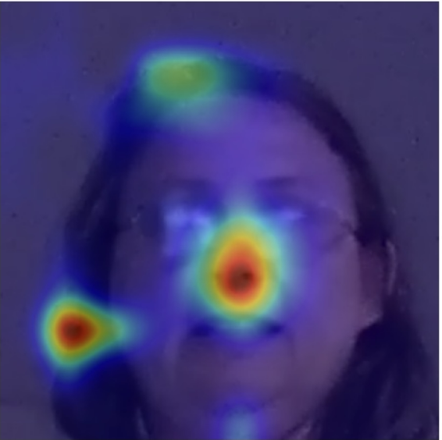
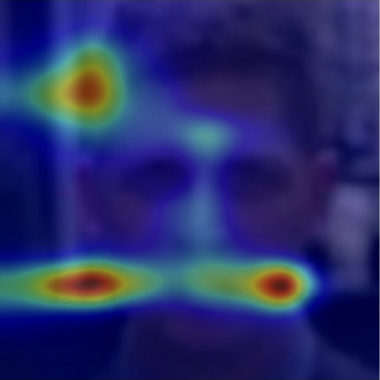
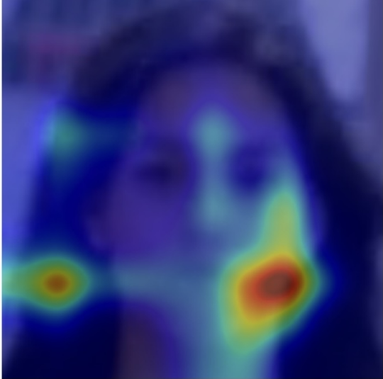
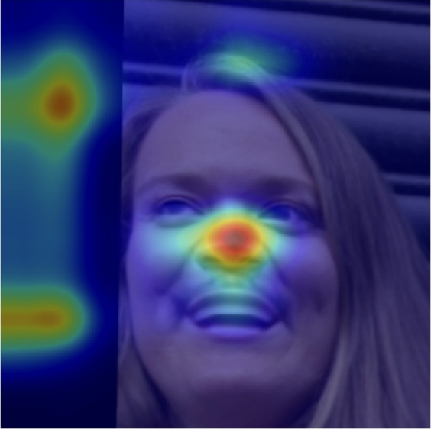
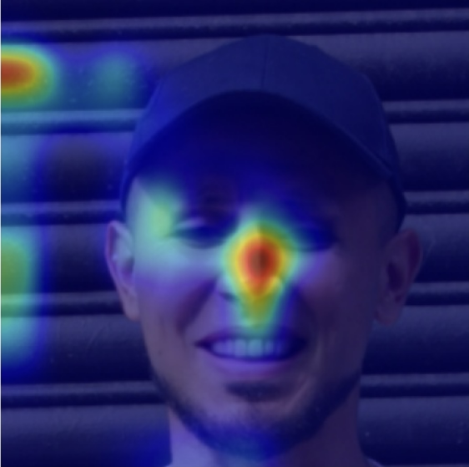
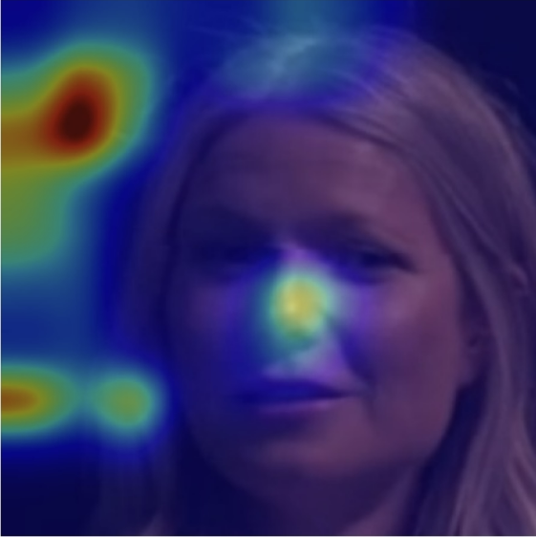
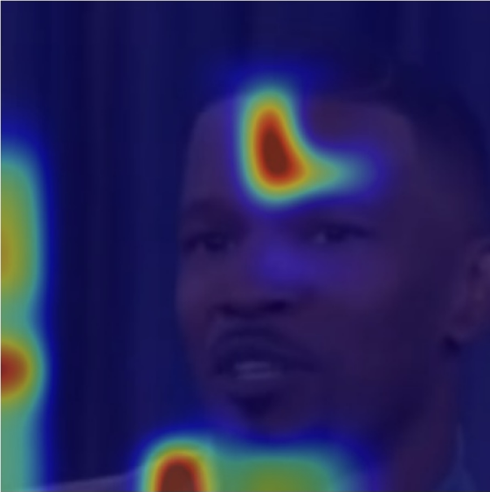
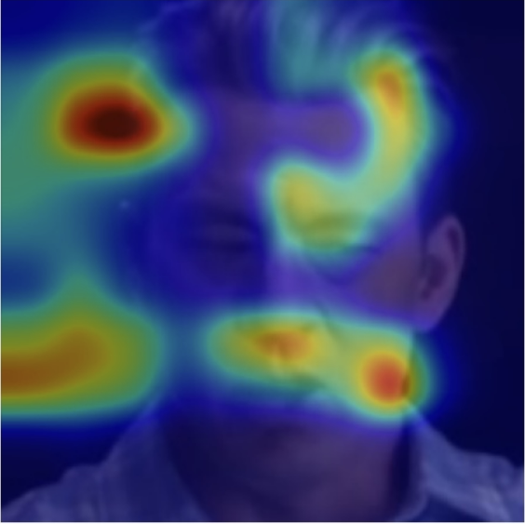
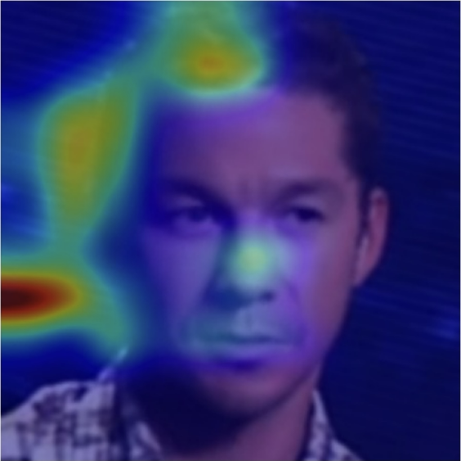
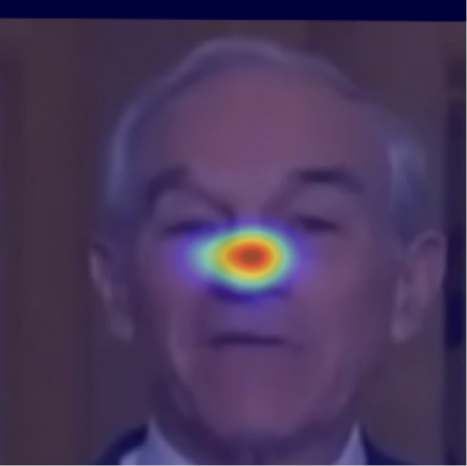
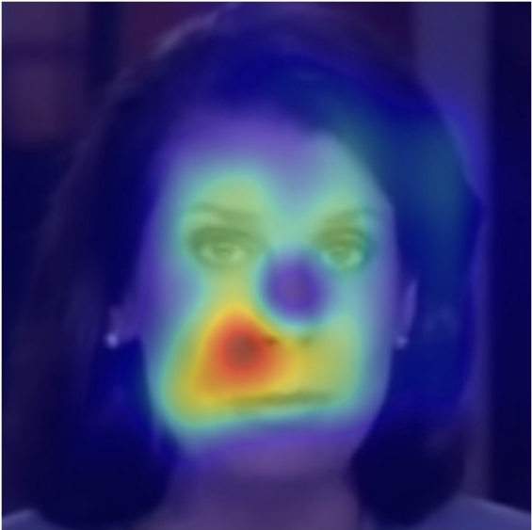
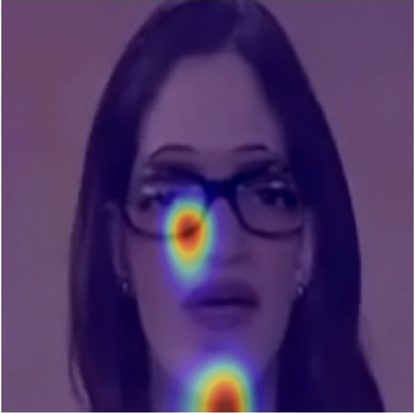
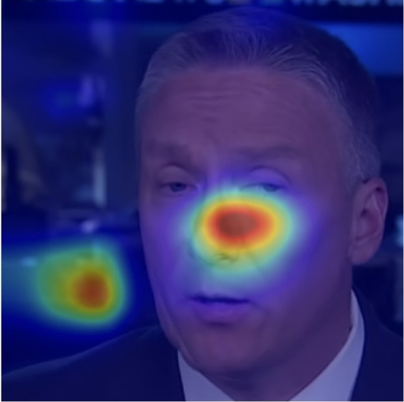
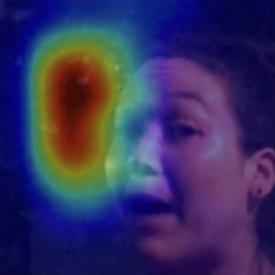
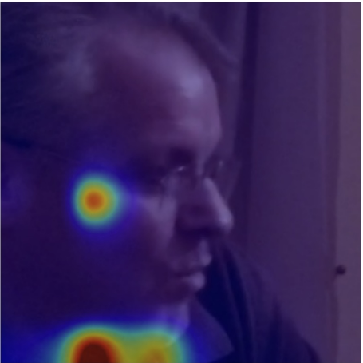
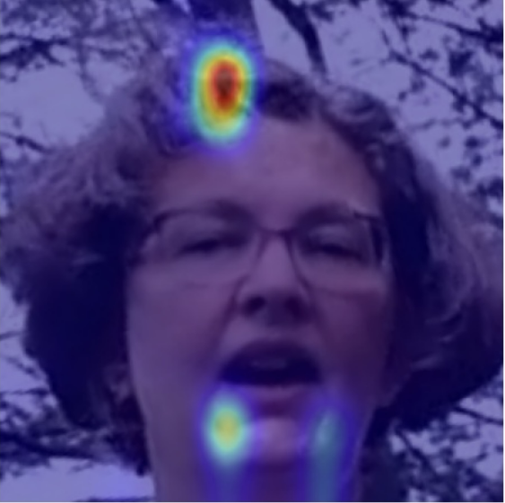
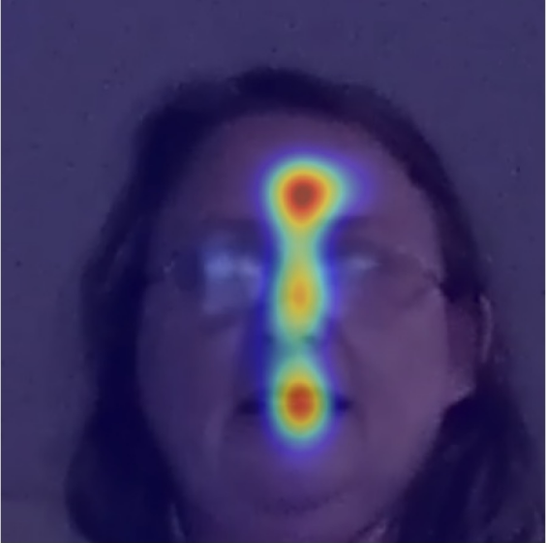
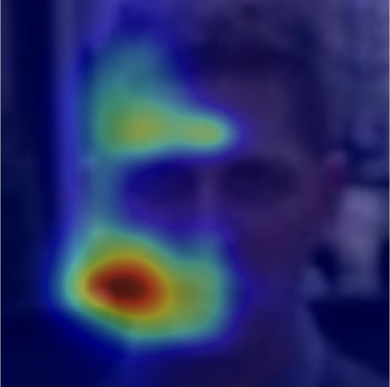
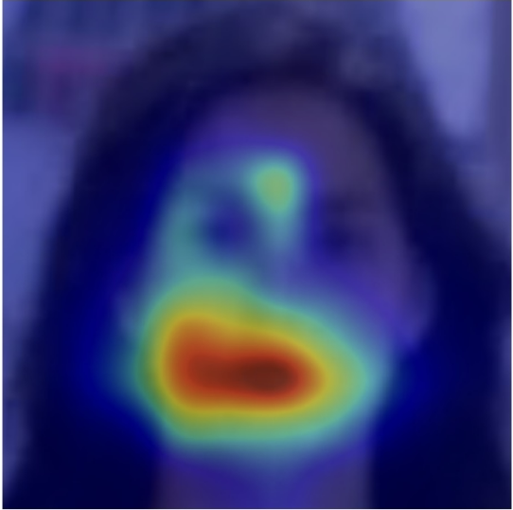
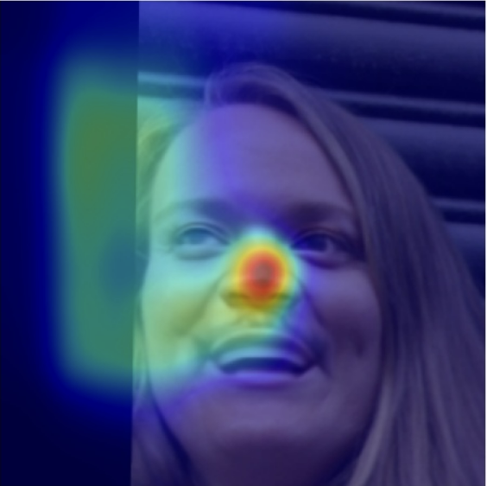
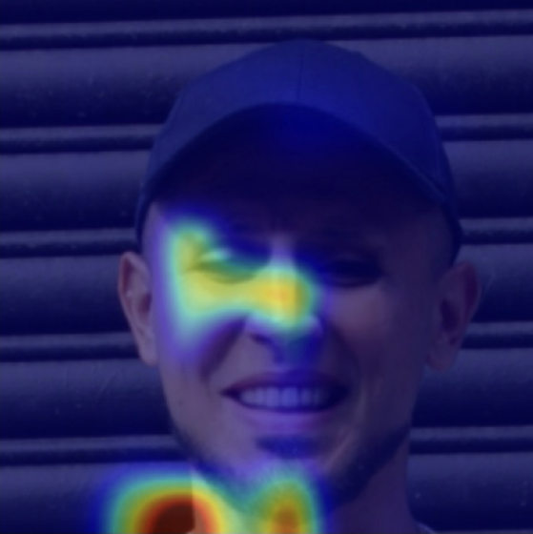
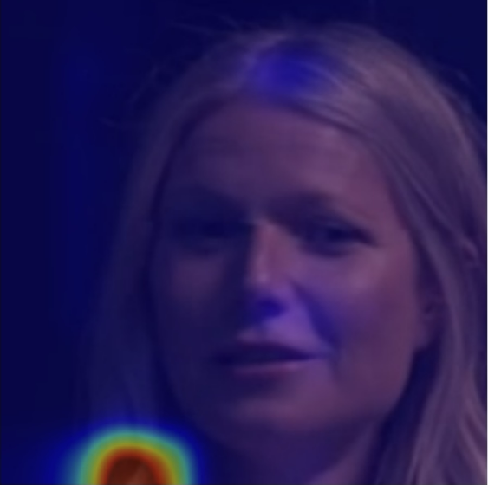
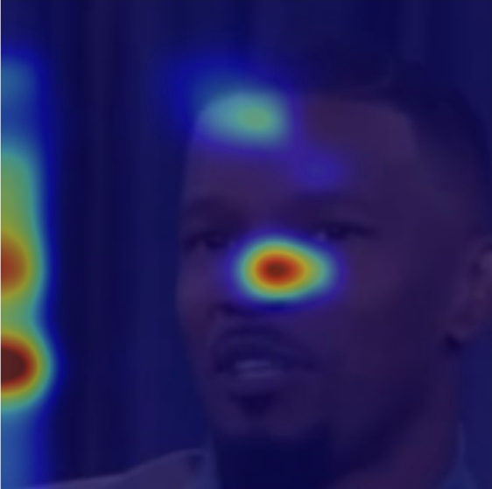
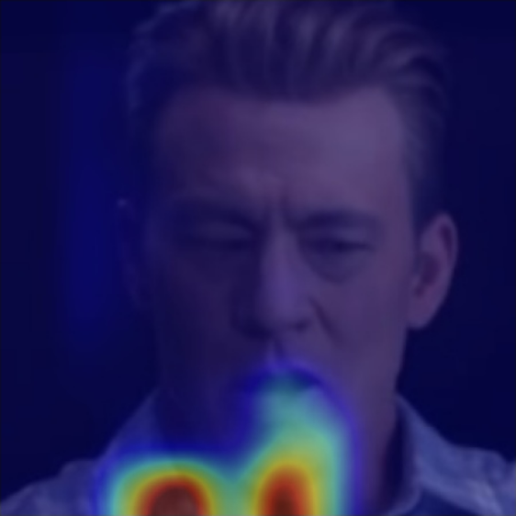
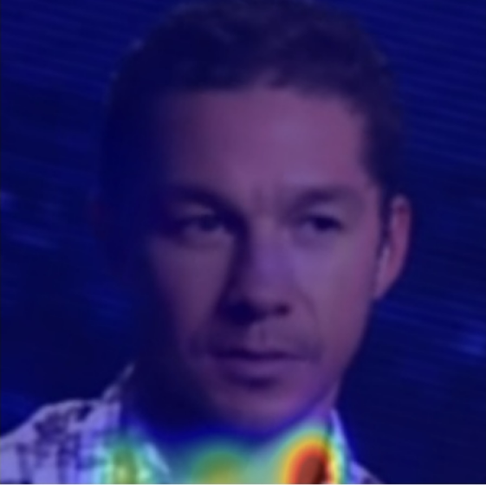
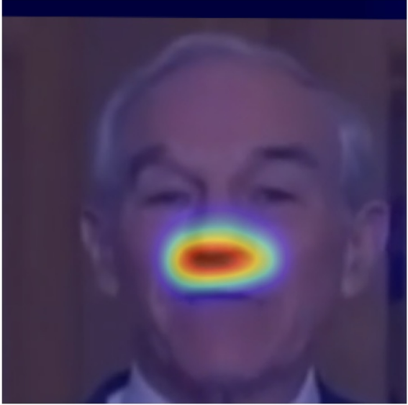
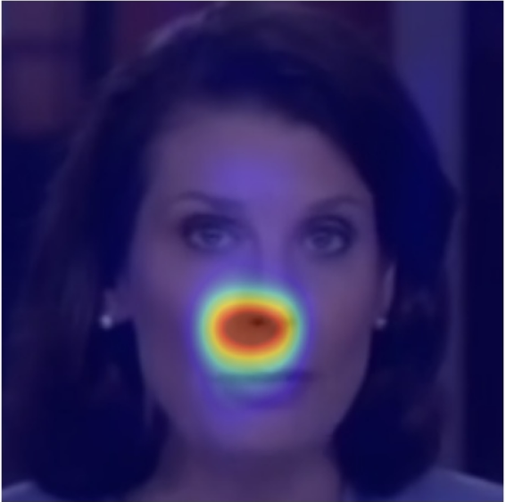
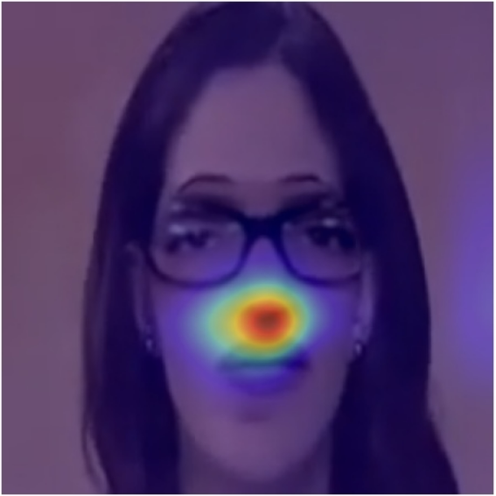
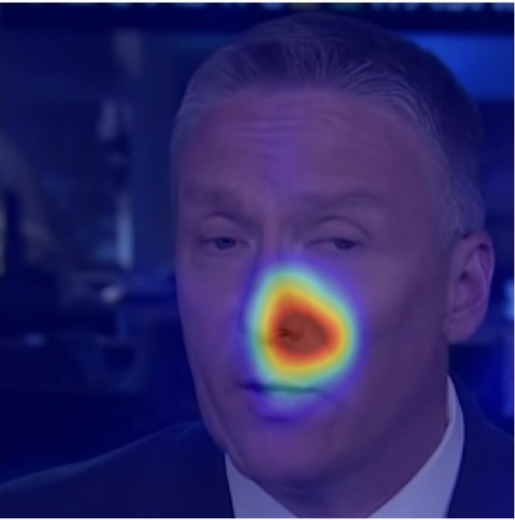
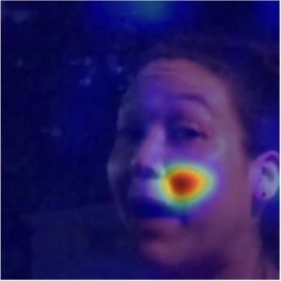











FF++ Real
FF++ Fake
DFDCP Real
DFDCP Fake
DFD Real
DFD Fake
CDF2 Real
CDF2 Fake
FT
LWF
Ours

Slide 4








Task1 True
/mnt/shared/deepfake/FF++/faces/original_sequences/youtube/c23/445.mp4/out00035.png
/mnt/shared/deepfake/FF++/faces/original_sequences/youtube/c23/388.mp4/out00038.png
/mnt/shared/deepfake/FF++/faces/original_sequences/youtube/c23/445.mp4/out00006.png
/mnt/shared/deepfake/FF++/faces/original_sequences/youtube/c23/388.mp4/out00102.png

Slide 5




/mnt/shared/deepfake/FF++/faces/manipulated_sequences/Face2Face/c23/371_367.mp4/out00048.png
/mnt/shared/deepfake/FF++/faces/manipulated_sequences/Face2Face/c23/906_847.mp4/out00037.png
Task1 Fake
/mnt/traffic/home/pankun/FF++/Deepfake-Detection-master/cam_img/20230503_1673_2.jpg

Slide 6












/mnt/shared/random/DFDC_Pre/faces/original_videos/1929178/1929178_K_003.mp4/out00056.png
/mnt/shared/random/DFDC_Pre/faces/original_videos/1941250/1941250_F_002.mp4/out00019.png
/mnt/shared/random/DFDC_Pre/faces/original_videos/1441897/1441897_E_002.mp4/out00027.png
Task2 True
/mnt/shared/random/DFDC_Pre/faces/original_videos/1604866/1604866_D_003.mp4/out00088.png
/mnt/shared/random/DFDC_Pre/faces/original_videos/1604866/1604866_D_003.mp4/out00088.png

Slide 7








Task2 Fake
/mnt/shared/random/DFDC_Pre/faces/method_A/748594/748594_F/1294671_748594_F_002.mp4/out00017.png
/mnt/shared/random/DFDC_Pre/faces/method_A/1681757/1681757_D/2076328_1681757_D_001.mp4/out00018.png
/mnt/shared/random/DFDC_Pre/faces/method_A/748594/748594_F/1294671_748594_F_002.mp4/out00017.png

Slide 8




/mnt/shared/deepfake/FF++/faces/original_sequences/actors/c23/06__walk_down_hall_angry.mp4/out00021.png
Task3 True
/mnt/shared/deepfake/FF++/faces/original_sequences/actors/c23/22__walking_down_street_outside_angry.mp4/out00045.png
/mnt/shared/deepfake/FF++/faces/original_sequences/actors/c23/22__walking_down_street_outside_angry.mp4/out00037.png

Slide 9




/mnt/shared/deepfake/FF++/faces/manipulated_sequences/DeepFakeDetection_old/raw/11_03__outside_talking_still_laughing__P08VGHTA.mp4/out00124.png
Task3 Fake
/mnt/shared/deepfake/FF++/faces/manipulated_sequences/DeepFakeDetection_old/raw/11_03__outside_talking_still_laughing__P08VGHTA.mp4/out00118.png
/mnt/shared/deepfake/FF++/faces/manipulated_sequences/DeepFakeDetection_old/raw/02_13__outside_talking_pan_laughing__2YSYT2N3.mp4/out00118.png

Slide 10
Task4 True
/mnt/shared/deepfake/Celeb-DF-v2/faces/Celeb-real/id60_0004.mp4/out00002.png
/mnt/shared/deepfake/Celeb-DF-v2/faces/Celeb-real/id51_0009.mp4/out00052.png

Slide 11




/mnt/shared/deepfake/Celeb-DF-v2/faces/Celeb-synthesis/id4_id20_0005.mp4/out00009.png
/mnt/shared/deepfake/Celeb-DF-v2/faces/Celeb-synthesis/id35_id9_0006.mp4/out00002.png
/mnt/shared/deepfake/Celeb-DF-v2/faces/Celeb-synthesis/id25_id22_0007.mp4/out00065.png

